Slide 1



HeuristicLab Hive
Deep Dive
C. Neumüller, A. Scheibenpflug

Slide 2
Motivation for HeuristicLab Hive
Experiments are very runtime consuming
many different optimization algorithms and parameter settings have to be executed and analyzed
very runtime consuming task, but parallelizable
Peak time demands
HPC infrastructure is overloaded before conference deadlines
Flexible resource usage
avoid explicit reservations
resources are used as long as they are needed
multicore resources can be shared
Utilize desktop computers of FH OÖ and research partners
hundreds of powerful multicore desktop machines can be used during the night
Notes:
Experimentation with different parameters
Peak times
Usage of university resources

Slide 3
Other Frameworks/Technologies
BOINC
C/C++, open source
no client groups, no timetables
Utilify
.NET, closed source
ParadisEO/ECJ
specialized for evolutionary algorithms (not generic)
Notes:
several open source frameworks
no c# frameworks

Slide 4
Hive vs. MPI
Hive | MPI
+ Slaves can be deployed anywhere (behind Firewall, NAT) | - Limited to HPC cluster
+ Slave management (groups) | + Node management with HPC tool
+ User/roles management | - No user management
+ Security (encrypted comm.) | - No encryption
+ Jobs/experiments stored in database | - API to send/receive jobs – no database
+ Automatic plugin deployment | - Manual plugin deployment
+ Timetables | + Time management
- No job intercommunication | + Job intercommunication
- Low performance comm. | + High performance comm.
Suited for coarse grained parallelization without intercommunication | Suited for fine grained parallelization with intercommunication
Notes:
several open source frameworks
no c# frameworks

Slide 5
HeuristicLab Hive Requirements
Open source, based on .NET and C#
Distributed execution of arbitrary jobs
not only HeuristicLab algorithms
Utilization of heterogeneous resources
HPC infrastructure, desktop computers, …
Scalability and Elasticity
add or remove slaves at any time (manually)
helps to overcome demand peaks
Time schedule
use some resources only during the night, in the holidays, …
Notes:
% * distributed computing of ``jobs'' - mainly heuristiclab algorithms
% * open source c# distributed computing
% * heterogenity - utilization of hpc infrastructure and desktop computers (multi core). also from other networks (bypass firewalls and nats) : because distribution time is not critical
% * elasticity, slaves can be added/removed any time - for peak demand
% * deployment of assemblies
% * security - groups, encryption, sandboxing

Slide 6
HeuristicLab Hive Requirements
Deployment of assemblies
jobs can specify assembly dependencies
slave loads assemblies into AppDomain for execution
no need to update slaves with new versions of software
Security
jobs can specify to be executed only on specific slaves
encrypted communication
sandboxed job execution
Notes:
% * distributed computing of ``jobs'' - mainly heuristiclab algorithms
% * open source c# distributed computing
% * heterogenity - utilization of hpc infrastructure and desktop computers (multi core). also from other networks (bypass firewalls and nats) : because distribution time is not critical
% * elasticity, slaves can be added/removed any time - for peak demand
% * deployment of assemblies
% * security - groups, encryption, sandboxing

Slide 7
HeuristicLab Hive Applications
Metaheuristic Optimization Experiments
execution of different instances of an algorithm with different parameter settings
intensively used by HEAL researchers to speed up tests
Algorithm Parallelization
Meta-Optimization
special parameter optimization algorithm
very expensive solution evaluation (done by HiveEngine)
ongoing master thesis
time on Hive: 1598,26 days (4 years, 4 months, 16 days) during approx. 5 weeks
Island Genetic Algorithm
islands compute distributed
for migration jobs are collected, migration happens locally

Slide 8
Changes in the last 6 months
HeuristicLab.Hive Deep Dive
http://dev.heuristiclab.com
8
Major refactoring in all components
Deploy Server on HL.Services and IIS integration
Prototype of Administration UI
Slave Windows Service and TrayIcon
Installers for Windows Service and TrayIcon
(true) Sandboxing
Better plugin management and plugin storage in DB
Job-Control: Pause, Stop, Abort
Hive Engine
Statistics are captured
Lot‘s of other improvements
Notes:
8

Slide 9
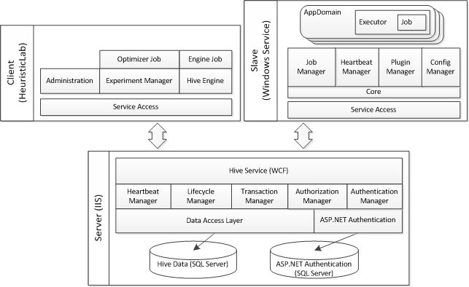
HeuristicLab Hive Architecture
HeuristicLab.Hive Deep Dive
http://dev.heuristiclab.com
9
Notes:
9

Slide 10
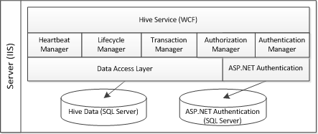
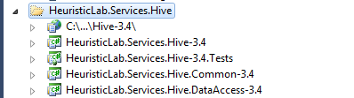
Hive Server Plugins
IIS deployment
Service implementation
Manager implementation
Unit tests for DAO and service
No usage of IIS
Service contract
Data Transfer Objects (DTOs)
Data Access Objects (DAOs)
Conversion to DTOs
LinqToSql
HeuristicLab.Hive Deep Dive
http://dev.heuristiclab.com
10
Notes:
10

Slide 11
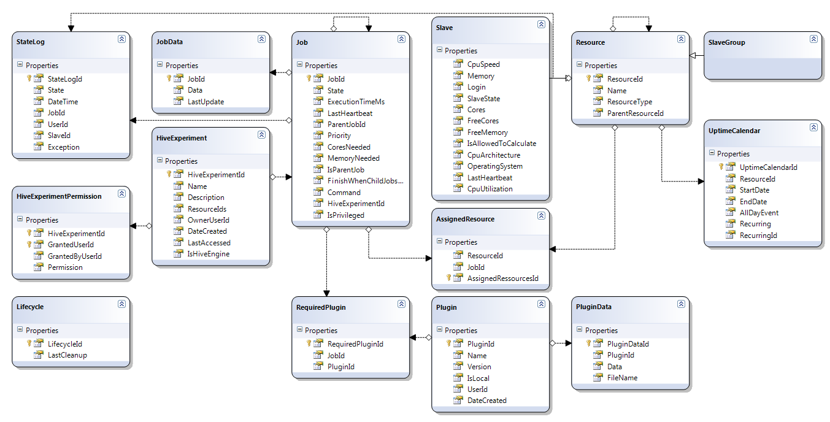
Hive Server Database
HeuristicLab.Hive Deep Dive
http://dev.heuristiclab.com
11
Notes:
11

Slide 12
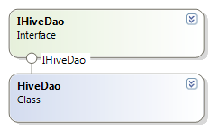
Hive Server Data Access Layer
HeuristicLab.Hive Deep Dive
http://dev.heuristiclab.com
12
IHiveDao
CRUD operations for
Job
JobData
Plugin
PluginData
Resource
Slave
SlaveGroup
HiveExperiment
HiveExperimentPermission
Appointment
Further methods
GetWaitingJobs
AssignJobToResource
GetStatistics
Notes:
12

Slide 13
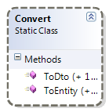
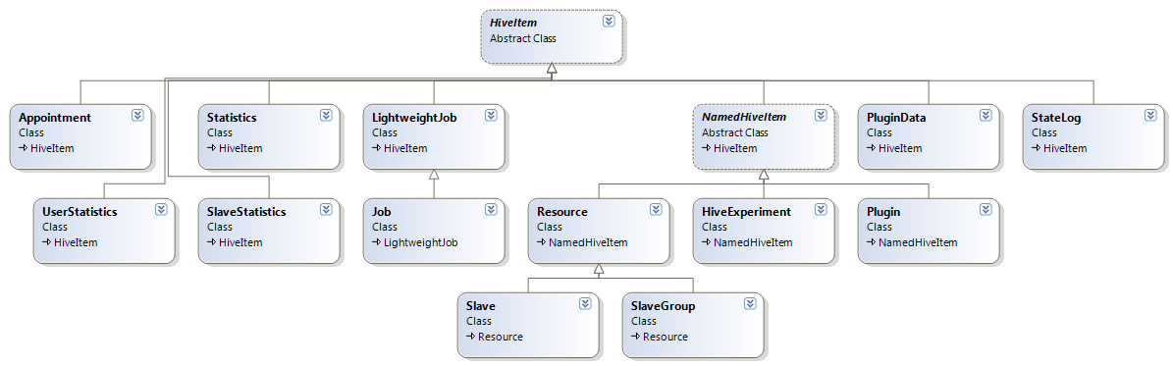
Hive Server Data Layer - DTOs
LinqToSqlEntities <-> DTOs
Business Logic uses only DTOs
HeuristicLab.Hive Deep Dive
http://dev.heuristiclab.com
13
Notes:
13

Slide 14
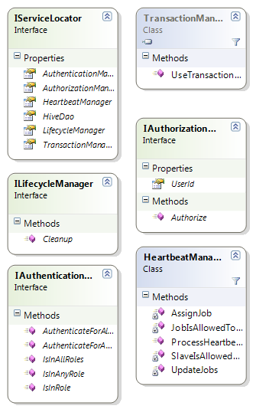
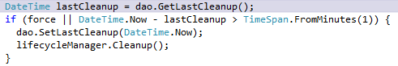
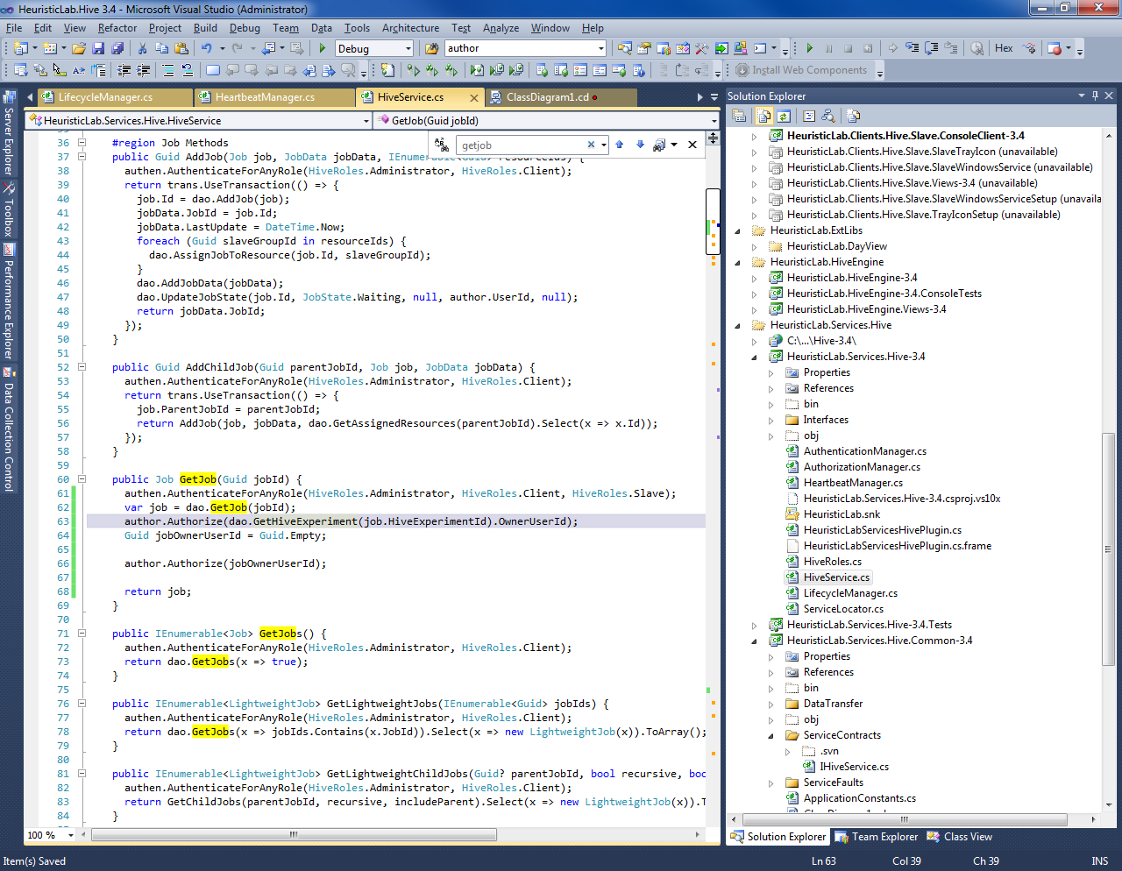
Hive Server Business Logic
ILifecycleManager
called 1x per minute
detection of timeouted slaves/jobs
update of statistics
IAuthorizationManager
checking of logged in user
Autorize(Guid userId) throws exception
IAuthenticationManager
checks for user roles
HeuristicLab.Hive Deep Dive
http://dev.heuristiclab.com
14
Notes:
14

Slide 15
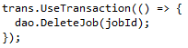
Hive Server Business Logic
TransactionManager
UseTransaction(Action action)
encapsules delegate in transaction
HeartbeatManager
processes heartbeats
update of execution time
returns actions for slave
assignment of jobs
pausing/stopping/aborting of jobs
checks if slave is assigned to job (if not -> abort)
checks timetable (if not allowed -> pause)
checks user commands (-> pause/stop)
HeuristicLab.Hive Deep Dive
http://dev.heuristiclab.com
15
Notes:
15

Slide 16
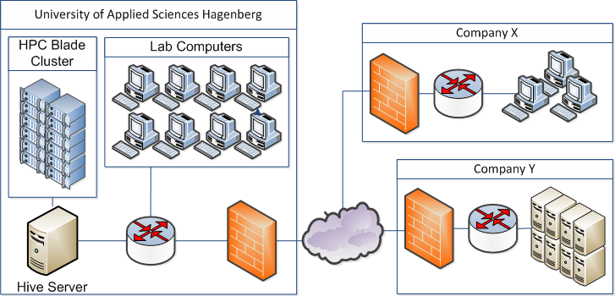
Hive Communication
Slave Communication
periodic messages containing current status (progress of jobs)
currently 10 sec.
communication is initiated only by slaves
avoid NAT and Firewalls problems
server response contains next actions
CalculateJob
AbortJob
StopJob
PauseJob
DoNothing
…
Notes:
Möglichkeit zur Ausweitung in die Cloud erwähnen

Slide 17
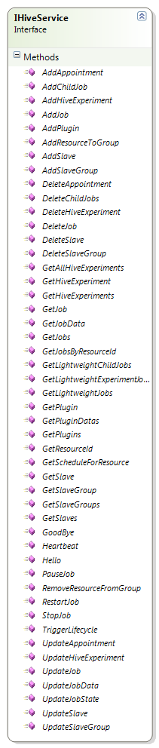
Hive Server Service
Implemented as PerCall WCF service
Does not contain any state
for better scalability
HeuristicLab.Hive Deep Dive
http://dev.heuristiclab.com
17
Notes:
17

Slide 18
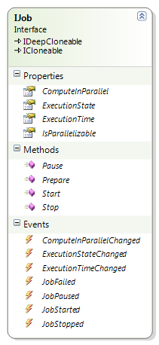
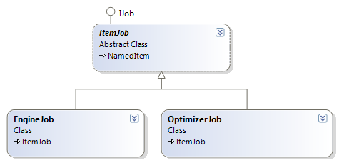
Hive Jobs
HeuristicLab.Hive Deep Dive
http://dev.heuristiclab.com
18
Implementations
ItemJob
abstract
inherits from NamedItem
encapsulates a HeuristicLab Item
OptimizerJob
encapsulates a HeuristicLab Optimizer (algorithm/experiment/batchrun)
EngineJob
encapsulates a HeuristicLab Engine with InitialOperator
can execute (a part of) an operator graph
Notes:
18

Slide 19
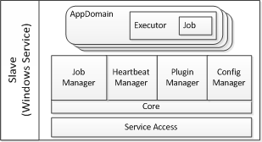
Hive Slave Overview
HeuristicLab.Hive Deep Dive
http://dev.heuristiclab.com
19
Executes jobs from the Hive server
Components:
Core
As Windows Service or
As Console Client
Slave TrayIcon
Sits in the taskbar
Communicates with Windows Service through pipes
Shows some statistics and current state
Installers for Windows Service and Slave TrayIcon
Notes:
19

Slide 20
Hive Slave Overview
HeuristicLab.Hive Deep Dive
http://dev.heuristiclab.com
20
Slave sends heartbeats
If schedule, free cores and state permits, jobs are fetched
Plugins for jobs are fetched and cached
Working directory and AppDomain for job is created
Job is executed
Jobs can be paused, stopped, aborted, …or they fail
Slave updates job states
And uploads results if everything worked fine
AppDomain is killed and working directory deleted
Notes:
20

Slide 21
Hive Execution States
HeuristicLab.Hive Deep Dive
http://dev.heuristiclab.com
21
Offline
Job has been created
Waiting
Job is waiting for a free Slave
Transferring
Job is transferred between Slave, Experiment Manager or Server
Calculating
Job is executed on Slave
Stopped
Job was stopped by user
Paused
Job was paused by user
Finished
Job is finished and results are stored on the Hive server
Notes:
21

Slide 22
Control over job:
Shift of job control:
Method which changes job state:
Method
Offline
Transferring
Waiting
Transferring
Calculating
Transferring
Finished
Client
UploadJob
AssignJob
Server
AddJob
DetermineAction
SendFinished
Job
SendFinished
Job
Slave
HeuristicLab.Hive Deep Dive
http://dev.heuristiclab.com
22

Slide 23
Hive Slave Commands
HeuristicLab.Hive Deep Dive
http://dev.heuristiclab.com
23
SayHello
CalculateJob
StopJob
StopAll
AbortJob
AbortAll
PauseJob
PauseAll
Sleep
Restart
ShutdownSlave
Notes:
23

Slide 24
Hive Slave Components (1/4)
HeuristicLab.Hive Deep Dive
http://dev.heuristiclab.com
24
Notes:
24

Slide 25
Hive Slave Components (2/4)
HeartbeatManager
Sends Heartbeats with info about slave (jobs…)
Receives messages from server and puts them into MessageQueue
Core
Pulls messages from queue
Decides what to do
Is responsible for application lifecycle (sleep, restart, shutdown)
Job related actions are handed over to JobManager
Only Core and HeartbeatManager talk to the Hive server
HeuristicLab.Hive Deep Dive
http://dev.heuristiclab.com
25
Notes:
25

Slide 26
Hive Slave Components (3/4)
JobManager
Responsible for job handling
Manages list of SlaveJobs
Forwards job related events
SlaveJob
Responsible for a single job
Starting/Stopping AppDomain
Reacts to events from AppDomain
Forwards commands to AppDomain
Thread for querying Executor
HeuristicLab.Hive Deep Dive
http://dev.heuristiclab.com
26
Notes:
26

Slide 27
Hive Slave Components (4/4)
Executor
Lives inside the AppDomain
Receives events from job
Forwards commands to job
Proxy for Executor is generated outside the AppDomain
ExecutorQueue
Communication through AppDomain borders
SlaveJob pulls messages from ExecutorQueue
→ Blocking call, Executor proxy lease gets renewed
Can’t set infinite lease time for proxy in a sandbox
HeuristicLab.Hive Deep Dive
http://dev.heuristiclab.com
27
Notes:
27

Slide 28
Hive Slave Sandboxing
HeuristicLab.Hive Deep Dive
http://dev.heuristiclab.com
28
Goal: Prevent execution of malicious code on Slave
AppDomains can be trusted or untrusted
Differences in Security Model .NET Version 4
Assemblies can be trusted or untrusted (mixed AppDomains)
Untrusted code can’t override security critical code (inheritance)
Untrusted code can’t call security critical code
E.g. MarshallByRefObject
E.g. GetTypes() on security critical code
So everything has to be not security critical code
Problems with UI libraries, PluginInfrastructure
Switch between Privileged and Unprivileged Sandboxing
Notes:
28

Slide 29
Hive Slave States
HeuristicLab.Hive Deep Dive
http://dev.heuristiclab.com
29
Offline
Not connected to Hive
Idle
Slave has no jobs to calculate
Busy
Jobs are currently running on slave
Asleep
No jobs are accepted at the moment
NoService
The slave windows service is currently not running
Notes:
29

Slide 30
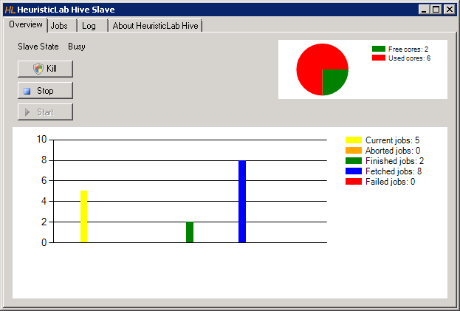
Hive Slave Demo
HeuristicLab.Hive Deep Dive
http://dev.heuristiclab.com
30
Notes:
30

Slide 31
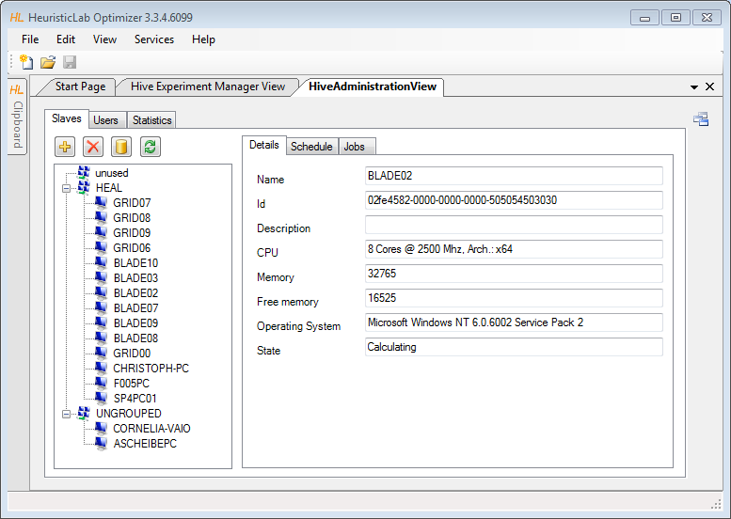
Administration UI
HeuristicLab.Hive Deep Dive
http://dev.heuristiclab.com
31
Notes:
31

Slide 32
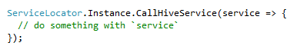
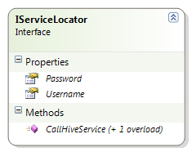
Experiment Manager Service Communication
HeuristicLab.Hive Deep Dive
http://dev.heuristiclab.com
32
svcutil for generation of
HiveServiceClient
DTOs
new local classes
extendable with `partial` mechanism
implement IItem
Service access via ServiceLocator
uses HeuristicLab username and password (by default)
Notes:
32

Slide 33
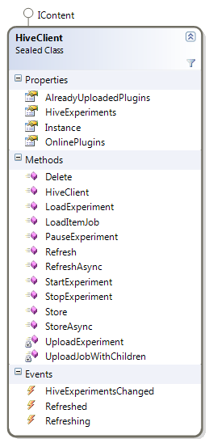
Experiment Manager Service Communication
HeuristicLab.Hive Deep Dive
http://dev.heuristiclab.com
33
HiveClient
store and refresh
holds instances
StartExperiment is implemented specially
Notes:
33

Slide 34
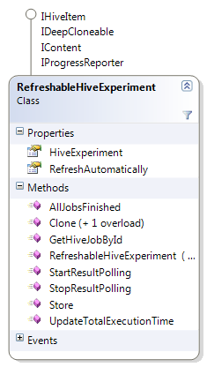
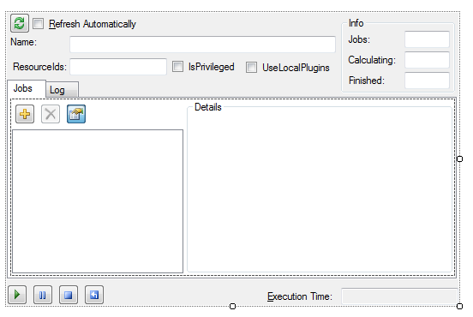
Experiment Manager
Is downloaded
before refresh
Downloads
jobs
HiveJobView
OptimizerHiveJobView
TreeView
HeuristicLab.Hive Deep Dive
http://dev.heuristiclab.com
34
RefreshableHiveExperiment
encapsulates a HiveExperiment
automatically refreshes itself
automatically downloads finished jobs
RefreshableHiveExperimentView
Notes:
34

Slide 35
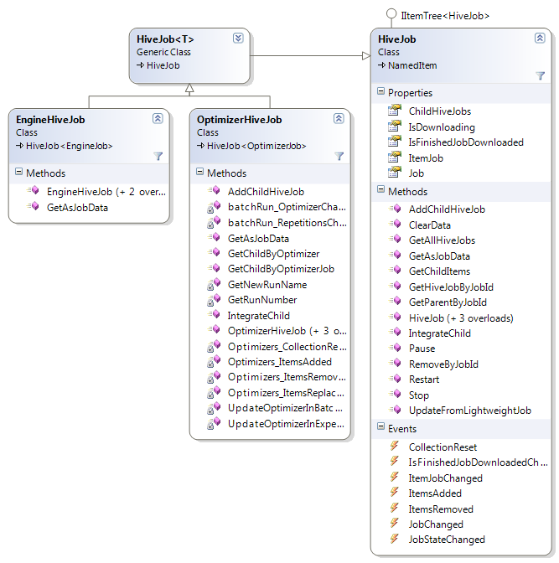
Experiment Manager
HiveJob<T>
encapsulates Job DTO and ItemJob
knows about child jobs
OptimizerHiveJob
listens to optimizer-events
BatchRun.RepetitionsChanged
BatchRun.AlgorthmChanged
Optimizer.OptimizersChanged
Job.ParallelChanged
creates/removes child jobs
EngineHiveJob
removes scope information in GetAsJobData
HeuristicLab.Hive Deep Dive
http://dev.heuristiclab.com
35
Notes:
35

Slide 36
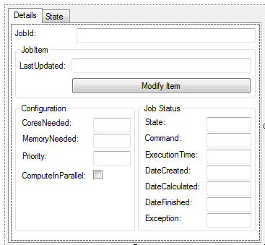
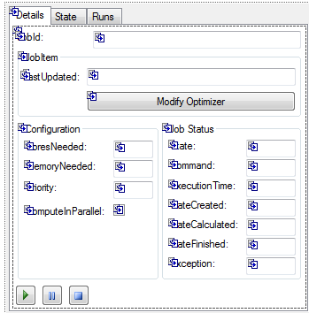
Experiment Manager
HiveJobView
configuration
job status information
state graph
OptimizerJobView
derived from HiveJobView
“shortcut” to Runs of the optimizer
start/pause/stop controls
HeuristicLab.Hive Deep Dive
http://dev.heuristiclab.com
36
Notes:
36

Slide 37
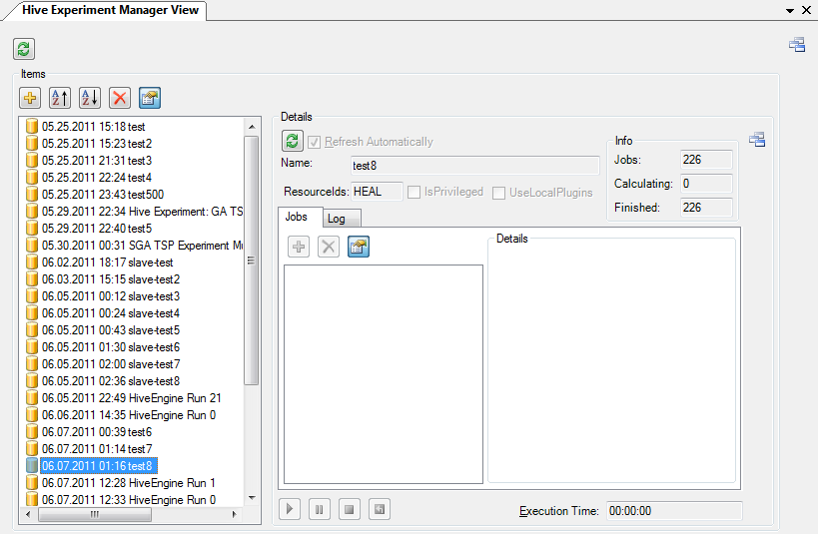
Experiment Manager
ExperimentManagerView
hive experiments ordered by date
information about finished jobs before download
HeuristicLab.Hive Deep Dive
http://dev.heuristiclab.com
37
Notes:
37

Slide 38
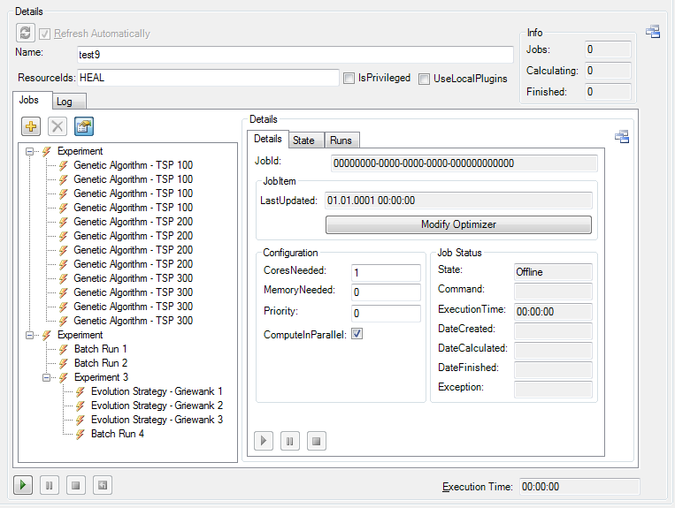
Experiment Manager
HiveExperimentView
drag and drop support
TreeView
Pause-> Modify-> Resume
HeuristicLab.Hive Deep Dive
http://dev.heuristiclab.com
38
Notes:
38

Slide 39
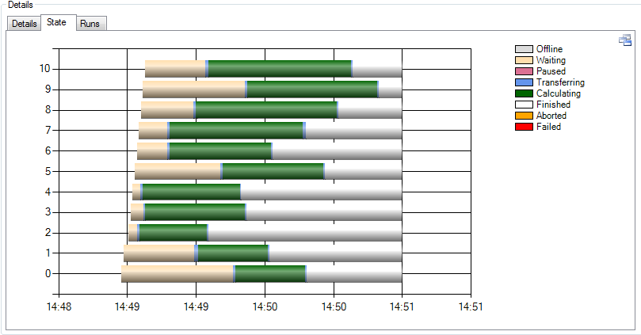
Experiment Manager
StateLog
every state transition is logged
nice for analyzing hive behaviour and performance
HeuristicLab.Hive Deep Dive
http://dev.heuristiclab.com
39
Notes:
39

Slide 40
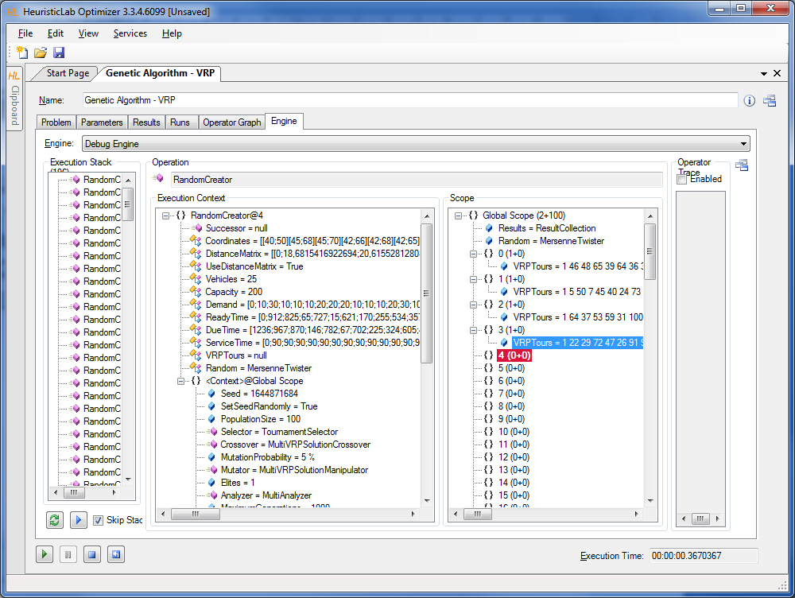
HiveEngine
UniformSubScopesOperators
Parallel=true
An EngineJob is created for operation in OperationCollection
Each operation contains a reference to a scope tree and execution context tree
Side-scopes are cut away!
Execution context tree is available but must not be modified!
Jobs can become large
HeuristicLab.Hive Deep Dive
http://dev.heuristiclab.com
40
Notes:
40

Slide 41
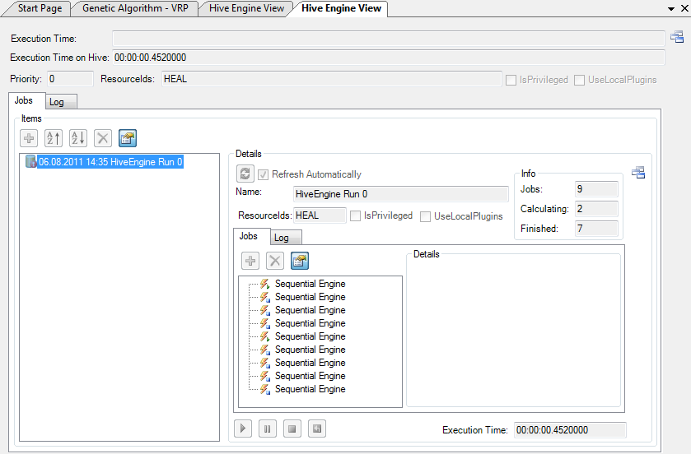
HiveEngine
HiveEngineView
reuse of RefreshableHiveExperimentView
HeuristicLab.Hive Deep Dive
http://dev.heuristiclab.com
41
Notes:
41

Slide 42
Hive Statistics
HeuristicLab.Hive Deep Dive
http://dev.heuristiclab.com
42
Captures hive status
every minute
also deleted jobs count in statistics
per user
total execution time
used cores
total execution time (only of finished jobs)
start-to-end time (only of finished jobs)
per slave
cores
free cores
memory
free memory
cpu usage
No HL views yet
Notes:
42

Slide 43
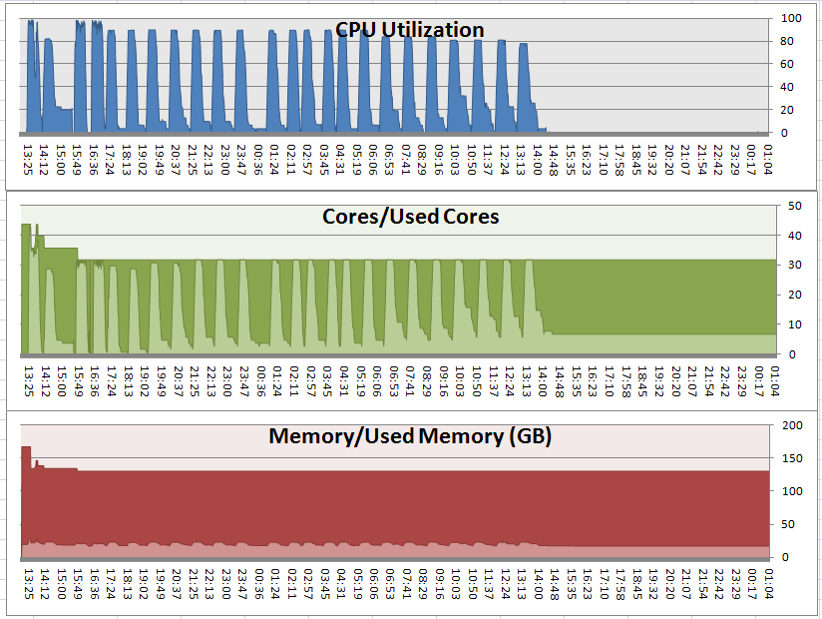
Hive Statistics
HeuristicLab.Hive Deep Dive
http://dev.heuristiclab.com
43
Excel visualization of a HiveEngine run of MetaOptimization
Notes:
43

Slide 44
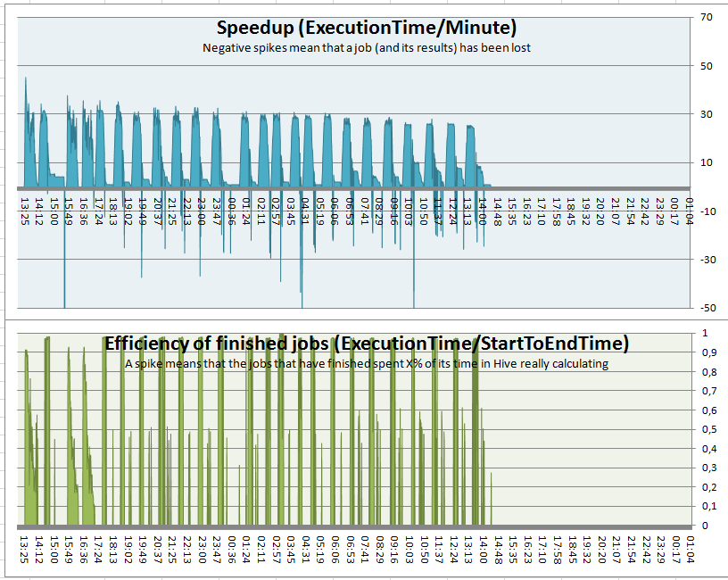
Hive Statistics
HeuristicLab.Hive Deep Dive
http://dev.heuristiclab.com
44
Excel visualization of a HiveEngine run of MetaOptimization
Notes:
44

Slide 45
To be done…
HeuristicLab.Hive Deep Dive
http://dev.heuristiclab.com
45
Use checksums for comparing assemblies → remove UseLocalPlugins
Experiment sharing
ExperimentManager and HiveEngine stabilization
Deployment in labs
Documentation
Code review
Testing!
Notes:
45

Slide 46
Future
HeuristicLab.Hive Deep Dive
http://dev.heuristiclab.com
46
Administration UI
Refactoring
Charts for collected statistics
User management (privileged role, priorities)
View and manage jobs on slave or in a group
View and manage jobs of users
TreeView refactoring
Improve scheduling
Priorities (DB + UI)
Integration with OKB computer and user management
Database timeouts (many large jobs at once are evil!)
Notes:
46

Slide 47

End of dive
HeuristicLab.Hive Deep Dive
http://dev.heuristiclab.com
47
Thanks for your attention!

